Slide 1
Data Collection

Slide 2
Outline
Introduction
What is Data Collection?
Primary Data Collection
Quantitative and Qualitative Data
Data Collection Tools
Secondary Data Collection

Slide 3
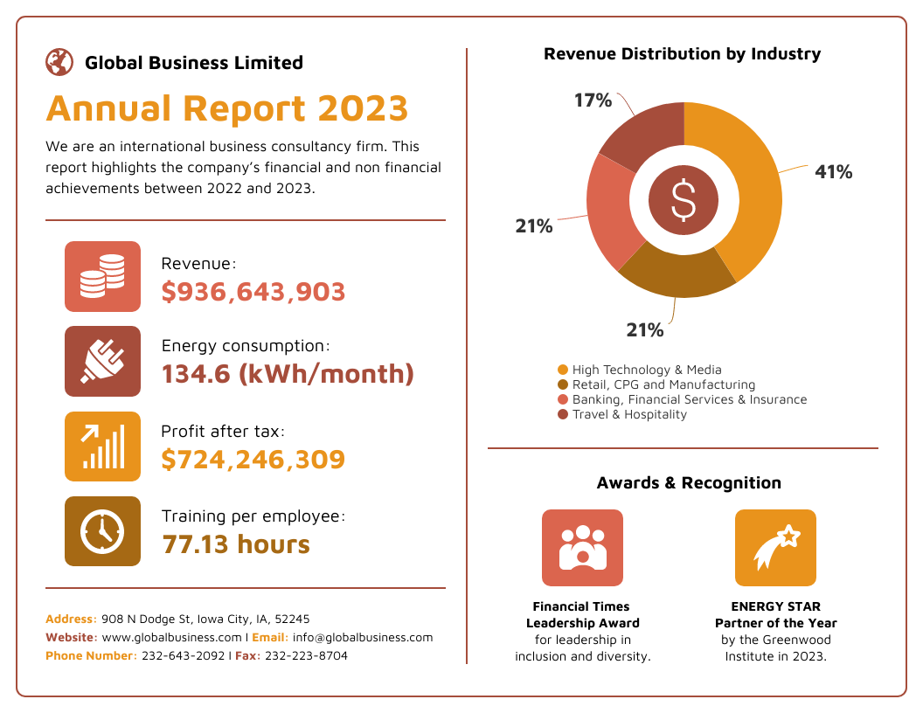
Introduction
Modern businesses run on data.
They regularly capture, store and analyze large amounts of data to which they can apply analytics to make strategic decisions and make some conclusions about their performance.

Slide 4
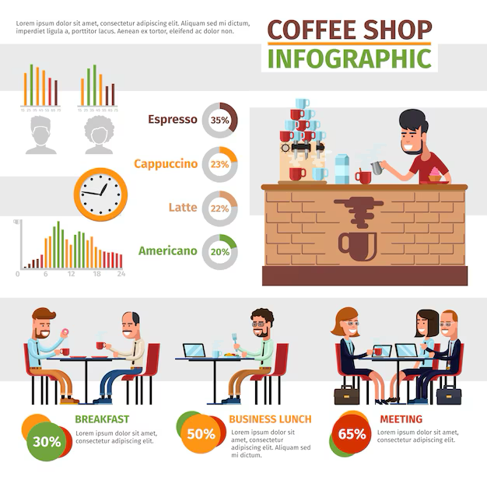
For example, in a coffee shop business, they may capture data about what selections the menu sells the most at a particular point in time.

Slide 5
Or they may capture information about the purpose of each customer’s visit or their demographic.

Slide 6
By gathering these data, a coffee shop can analyze them and know amount of stock they need to purchase based on customer demand.

Slide 7
Or add more selections in the menu based on the purpose of visit of each customers.

Slide 8
Thus, data collection is essential to analyze the performance of any business, whether to solve a problem and making assumptions about specific things when required.

Slide 9
What is Data Collection
In statistics, data collection is a process of gathering information from all relevant sources to find a solution to a research problem.
The data collection methods allow a person to conclude an answer to the relevant question.
Most of the organizations use data collection methods to make assumptions about future probabilities and trends.

Slide 10
What is Data Collection
Depending on the type of data, the data collection method is divided into two categories namely,
Primary Data Collection
Secondary Data Collection

Slide 11
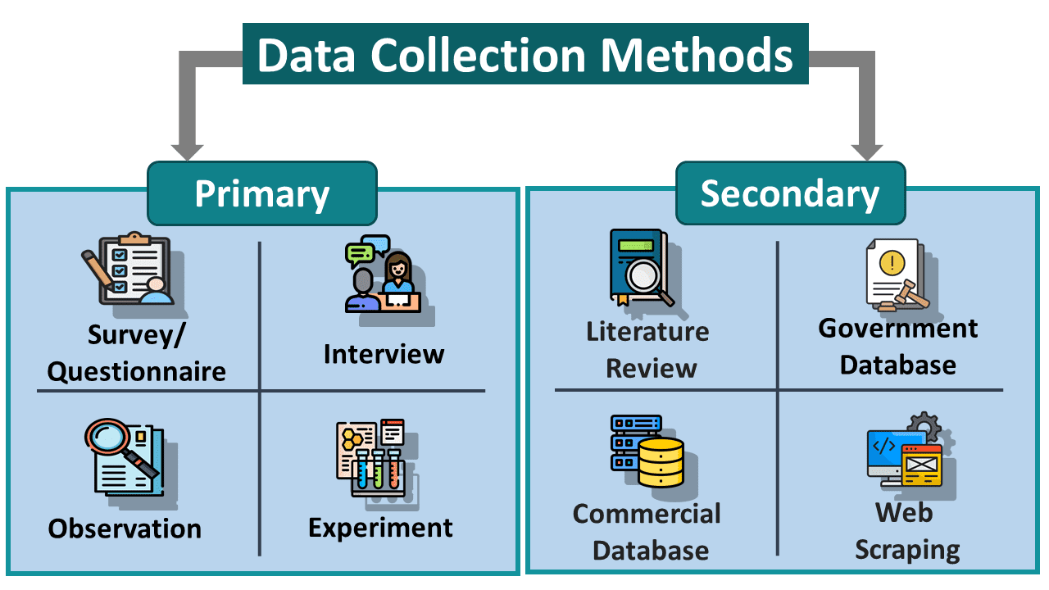

Slide 12
Outline
Introduction
What is Data Collection?
Primary Data Collection
Quantitative and Qualitative Data
Data Collection Tools
Secondary Data Collection

Slide 13
Primary Data
Primary data or raw data is a type of information that is obtained directly from the first-hand source through experiments, surveys or observations.

Slide 14
Primary Data
The primary data collection method is further classified into two types. They are
Quantitative Data Collection Methods
Qualitative Data Collection Methods

Slide 15
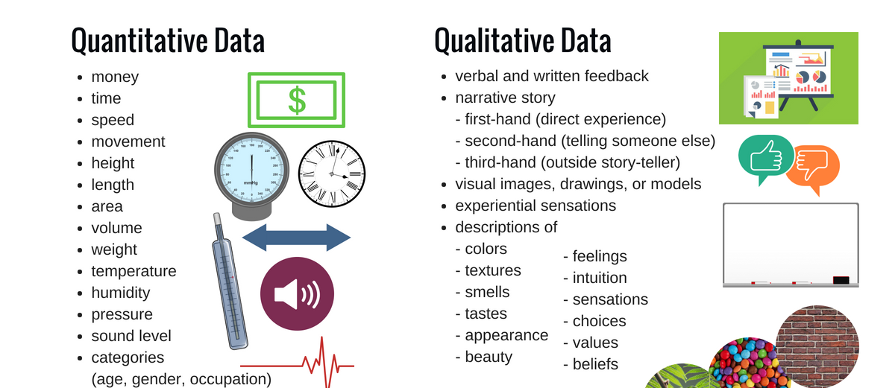

Slide 16
Quantitative Data Collection
Quantitative Data is information that can be measured, counted, and expressed in numerical values, answering questions like "how much," "how many," or "how often".
It can be divided into two main types:
Discrete (countable, like the number of students).
Continuous (measurable within a range, like height or temperature).

Slide 17
Qualitative Data Collection
Qualitative data is non-numerical information used to understand concepts, opinions, and experiences, collected through methods like interviews, observations, and text analysis.

Slide 18
Data Collection Tools
Data collection tools includes
Surveys
Questionnaires
Interviews
Observations

Slide 19
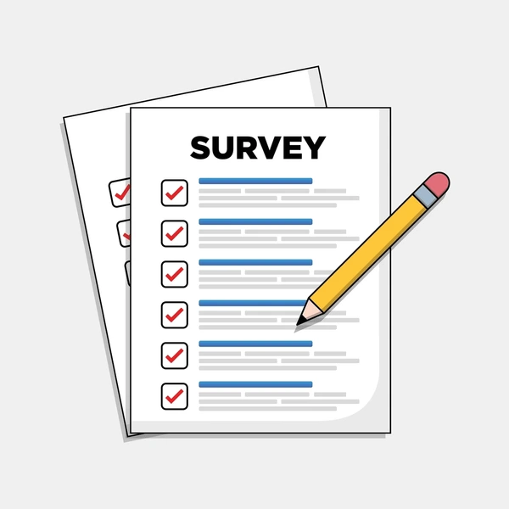
Surveys
Surveys allow you to collect data about opinions, behaviours, experiences, and demographic characteristics by asking people directly.
Surveys are ideal for documenting perceptions, attitudes, beliefs, or knowledge within a clear, predetermined sample of individuals.

Slide 20

Surveys
Surveys can be done using questionnaires where you ask people to fill out questions themselves

Slide 21

Surveys
Or conduct interviews where you ask questions and record the answers.

Slide 22
Questionnaires
Questionnaires are more common in quantitative research.
They usually include closed questions with multiple-choice answers or rating scales.

Slide 23
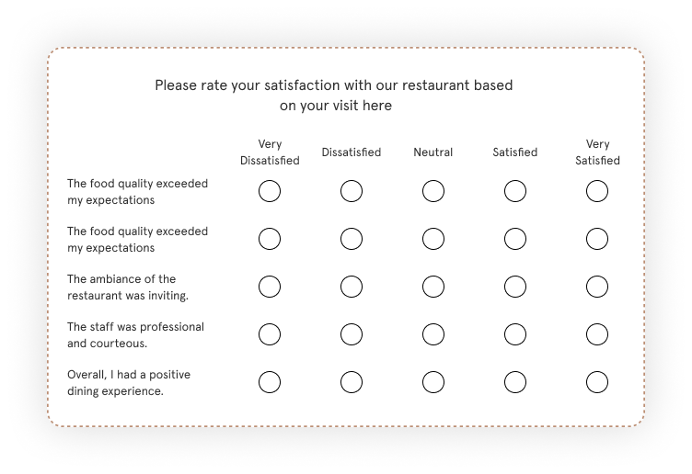

Slide 24
Questionnaires
They can also be used to obtain qualitative data by asking open-ended questions with a free-text format.

Slide 25
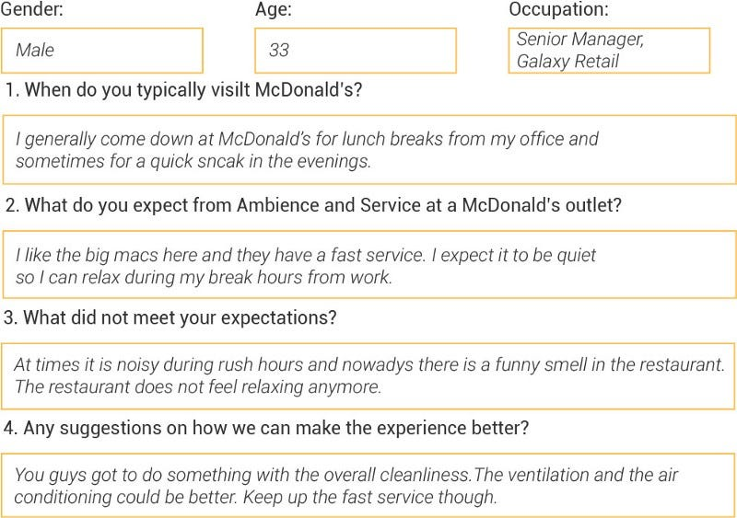

Slide 26
Questionnaires
Open-ended questions should be specific enough to yield coherent responses across respondents, yet broad enough to invite a spectrum of answers.

Slide 27
Questionnaires
This allows you to collect consistent data from many people and analyze the responses statistically.

Slide 28
Questionnaires
For example, if you want to measure student satisfaction with their teacher, you could use a questionnaire to collect responses from many students.

Slide 29
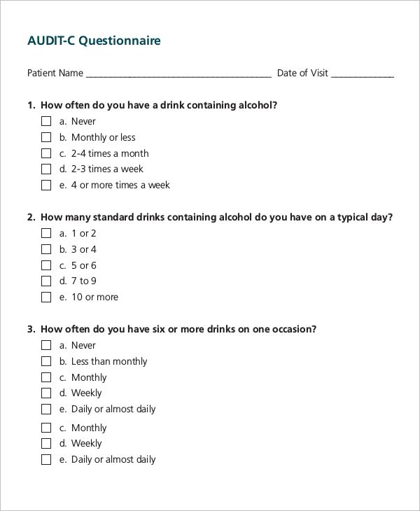
For example, if you want to measure alcoholic consumption of a patient, you could use a questionnaire to collect responses from many patients.

Slide 30
Interviews
Interviews are more common in qualitative research.
They usually allow participants to answer questions in their own words.

Slide 31
Interviews
Interviews are ideal when used to document participants' accounts, perceptions of, or stories about attitudes toward and responses to certain situations or phenomena.

Slide 32
Type of Interviews
They can be structured or unstructured
Interviews can either follow a tightly written script that mimics a survey or be inspired by a loose set of questions that invite interviewees to express themselves more freely

Slide 33
Interviews vs Surveys
Many research questions that can be answered with surveys can also be answered through interviews, but interviews will generally yield richer, more in-depth data than surveys.

Slide 34
Interviews vs Surveys
Unlike questionnaires, you can ask a follow-up question and explore ideas in more depth.

Slide 35
Disadvantages of Interviews
Because interviewers are the instruments of data collection, interviewers should be trained to collect comparable data.

Slide 36
Disadvantages of Interviews
The number of interviews required depends on the research question and the overarching methodology used.

Slide 37


Slide 38
When to use an interview
You wish to gather very detailed information
You anticipate wanting to ask respondents follow-up questions based on their responses
You plan to ask questions that require lengthy explanation
You are studying a complex or potentially confusing topic to respondents.
You are studying processes, such as how people make decisions

Slide 39
Observations
Observations allow you to collect data unobtrusively, observing characteristics, behaviours or social interactions without relying on self-reporting.

Slide 40
Observations
Observations may be conducted in real time, taking notes as you observe, or you might make audio visual recordings for later analysis.

Slide 41
Quantitative observation
Quantitative observation involves systematically measuring or counting specific events, behaviours, characteristics etc.

Slide 42
Quantitative observation
With this method, it is important to have a clear objective rules to ensure you count the same thing consistently.
You also need to clearly define the categories and criteria of your observation in advance.

Slide 43
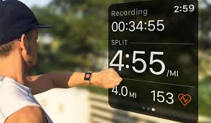
Quantitative observation
For example, to research your own improvement in running, you could observe your performance directly using a running application.

Slide 56
Qualitative observation
Qualitative observation involves taking detailed notes and writing rich descriptions of what is observed.
This means that you do not have to decide in advance how to categorize your observations.

Slide 57
Observations
In theory, observations allow you to collect data on how people really behave and not just how they say they do.
But keep in mind that being observed may make people behave differently than they normally would.

Slide 58
Outline
Introduction
What is Data Collection?
Primary Data Collection
Quantitative and Qualitative Data
Data Collection Tools
Secondary Data Collection

Slide 59
Secondary Data
In media and communication, you might collect speeches samples of texts to be analyzed. (e.g speeches, articles or social media posts)

Slide 60
Secondary Data
In psychology, you might use technologies like neuroimaging, eye-tracking to measure things such as attention or reaction time.

Slide 61
Secondary Data
In education, you might use tests or assignments to collect data about knowledge and skills.

Slide 62
Secondary Data
In physical sciences, you might use specific instruments to measure things such as weight, blood pressure or chemical composition.

Slide 63
Secondary Data
What If you do not have the time or resources to collect data from the population you to study?
Instead of collecting your own data, you can use secondary data that other researchers already collected.

Slide 64
Secondary Data
For example, datasets from government surveys or previous studies on your topic.
With this raw data, you can do your own analysis to answer new research questions that were not addressed by the original study.

Slide 65
Advantages of using Secondary Data
Using secondary data gives you access to much larger and more varied samples than you could collect yourself.

Slide 66
Limitations of using Secondary Data
However, it also means that you do not have any control over which variables to measure or how to measure them, so the conclusions you can draw may be limited.

Slide 67
References
https://pmc.ncbi.nlm.nih.gov/articles/PMC4857496/#:~:text=Interviews%20are%20used%20to%20gather,and%20the%20overarching%20methodology%20used.

